Slide 1
Concurrency — Exercise 9

Slide 2
Problem 1
Implement the banking example with Scala and Akka actors. You may reuse the code from the lecture. Write a simple test program that runs two concurrent tasks each of which executes a big number of deposit and withdraw operations on a single account that sum up to a well-known balance, e.g., of 0. Use Scala futures to run the concurrent tasks. Insert useful output operations in your code to check that the two threads are run interleavingly, and that the resulting balance is correct.

Slide 3
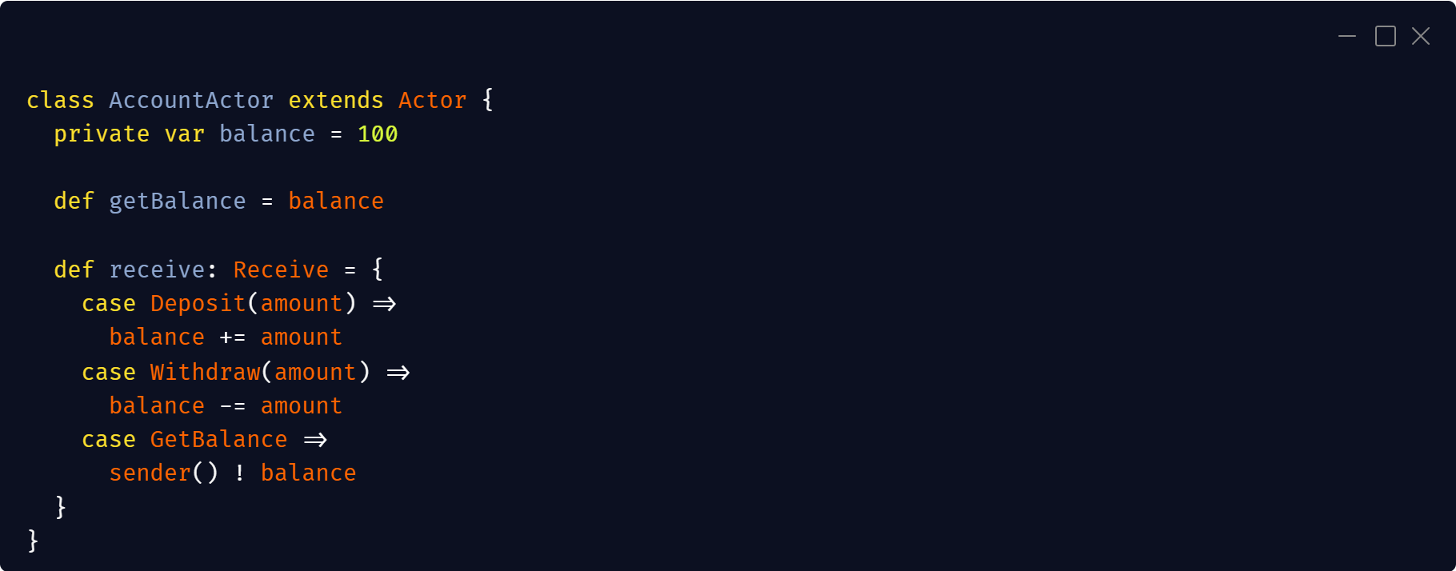

Slide 4
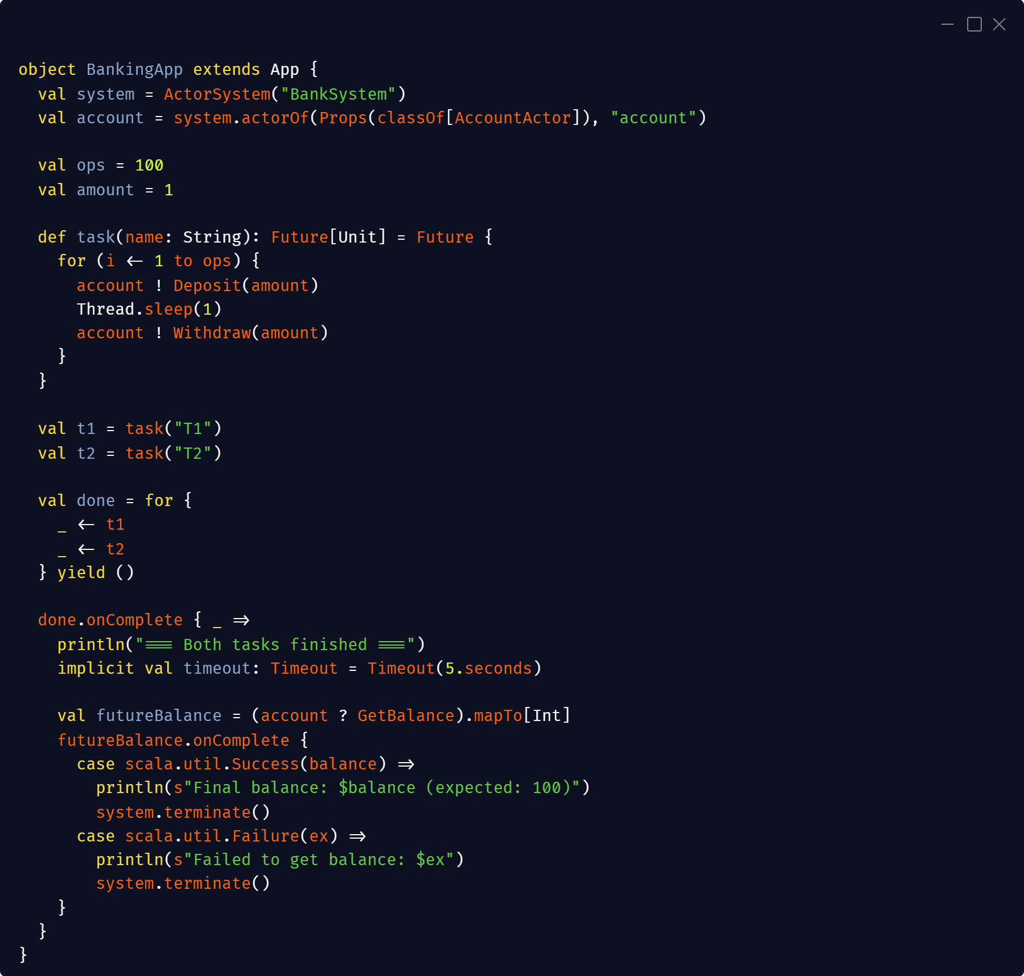

Slide 5
Problem 2
Use multi-producer single-consumer channels to implement a communication-based solution to the banking example in Rust.

Slide 6
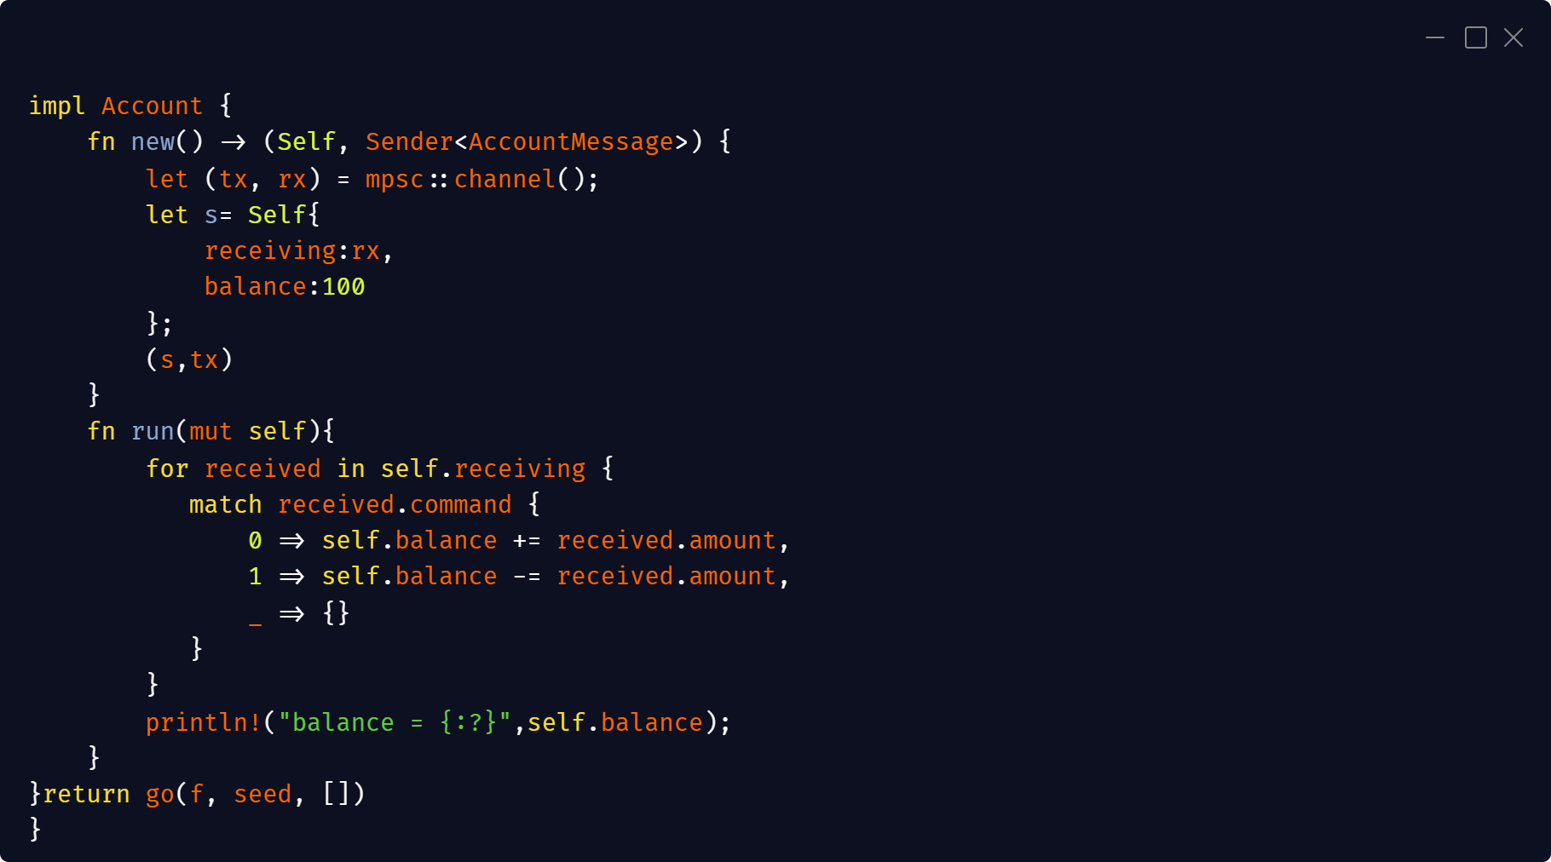

Slide 7
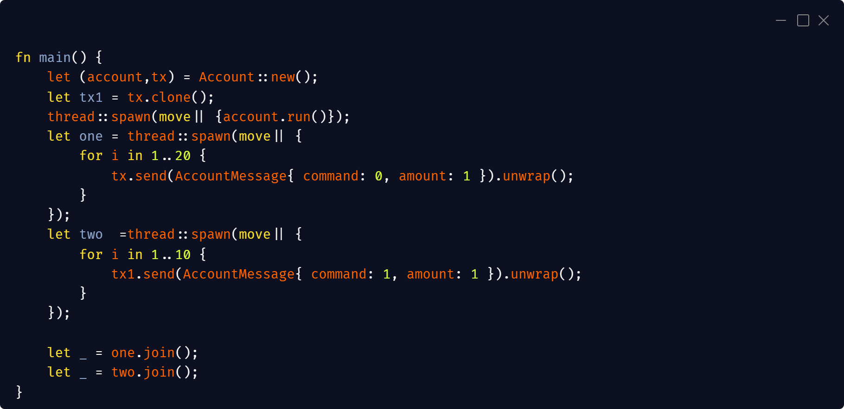

Slide 8
Problem 3
Now extend your banking actor such that it not only performs the deposit and withdraw operations, but returns the new balance back to the sender of the command. Because the existing MPSC channel is unidirectional, this requires backchannels from the actor to the senders. You might find these instructions helpful:

Slide 9
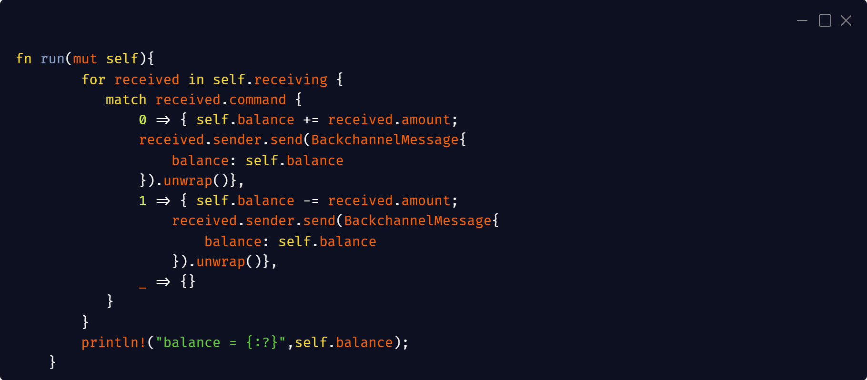

Slide 10
